Slide 1
19 October 2016
Phenotype Analysis in Complex trait genomics
Sailendra Pradhananga
DNA CLUB FALL 2015
Notes:
Good morning and welcome to my presentation.
My name is Sailendra Pradhananga and I am a PhD student at Jaokim and pelin group .
Today in this DNA club I will be presenting on analysis of Toxicity phenotype for complex trait

Slide 2

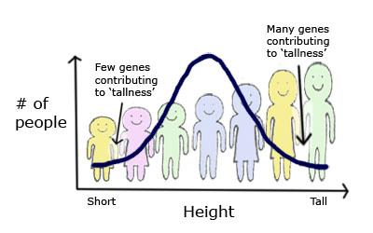
Background:
Phenotype → Traits that could be observed
Complex Phenotype = Environmental + Genetic interaction

Slide 3
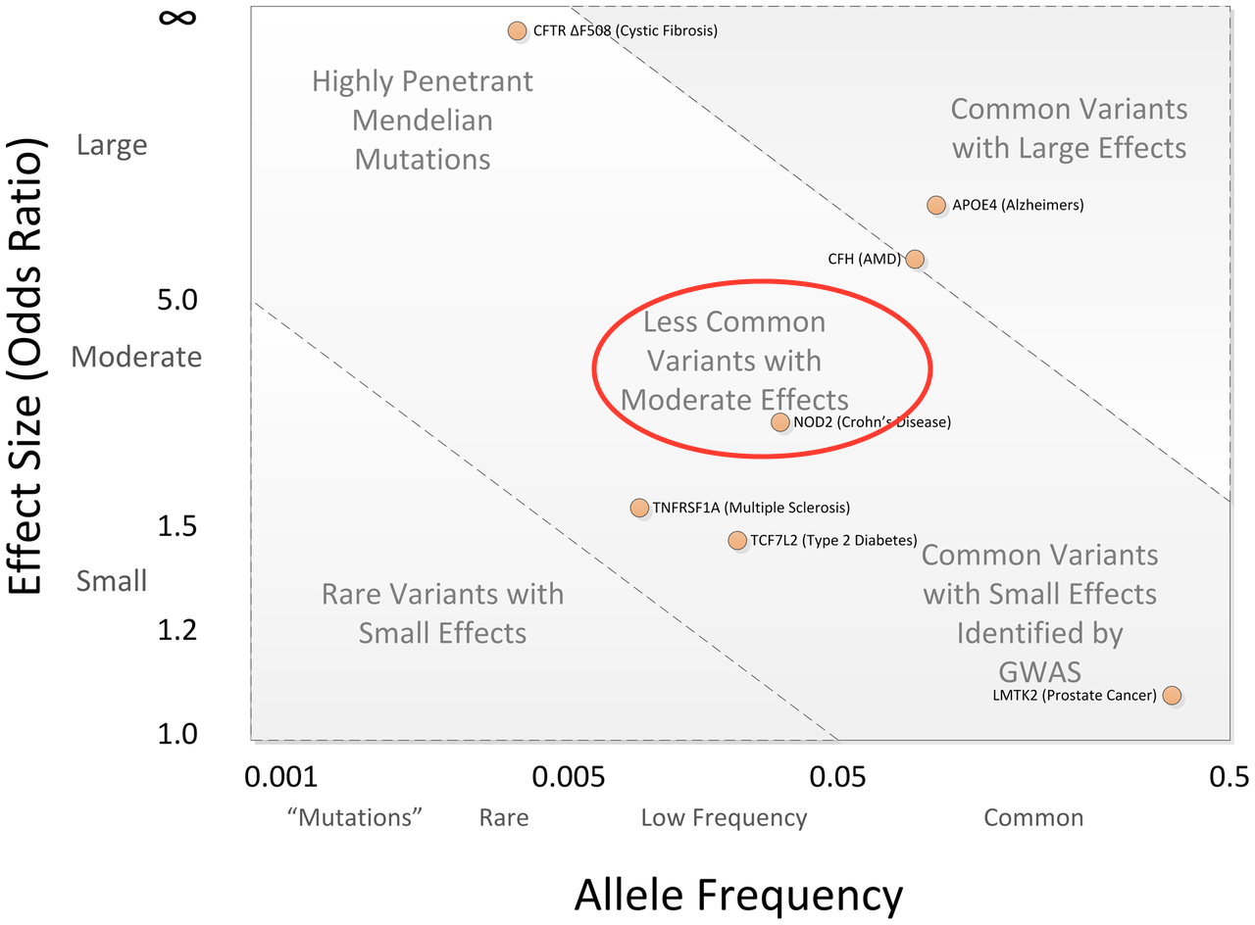
One approach: GWAS
Genetic architecture of complex traits and diseases
New insights into normal physiology and disease pathophysiology
Conventionally used for Common variants with low effect size
However, unable to explain functionality in complex disease
Modern sequencing based GWAS targets

Slide 4
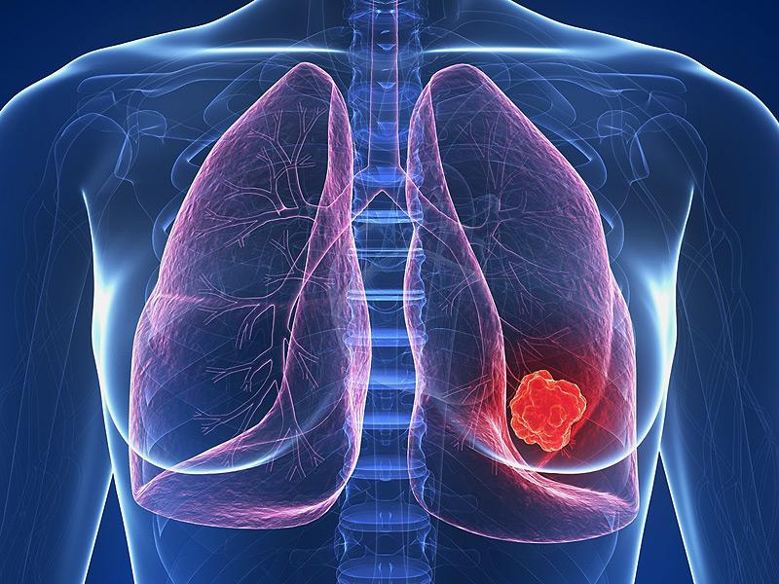

Drug induced myelosuppressive toxicity in Lung cancer
Lung cancer → Common cancer with high mortality rate
Chemotherapy → Cocktail of drugs administered
HIGH Toxicity
LOW
Toxicity
Serious side effect of chemotherapy
Multitude of genes involved in the traits
AIM : Explain variability in myelosuppression response in Lung cancer patients
Myelosuppression toxicity
decrease in blood cells
Notes:
Serious side effect of chemotherapy
multitude of genes involved in the traits

Slide 5
The toxicity project so far...
Study cohort of 215 patient of proclaimed Swedish descent
Same regimen of treatment admininstered
Whole exome sequencing was performed in previous studies
Few gene centric SNV variants reported and validated
Subsequently, scaled up to whole genome sequencing of 96 extreme phenotypes of high and low toxicity

Slide 6
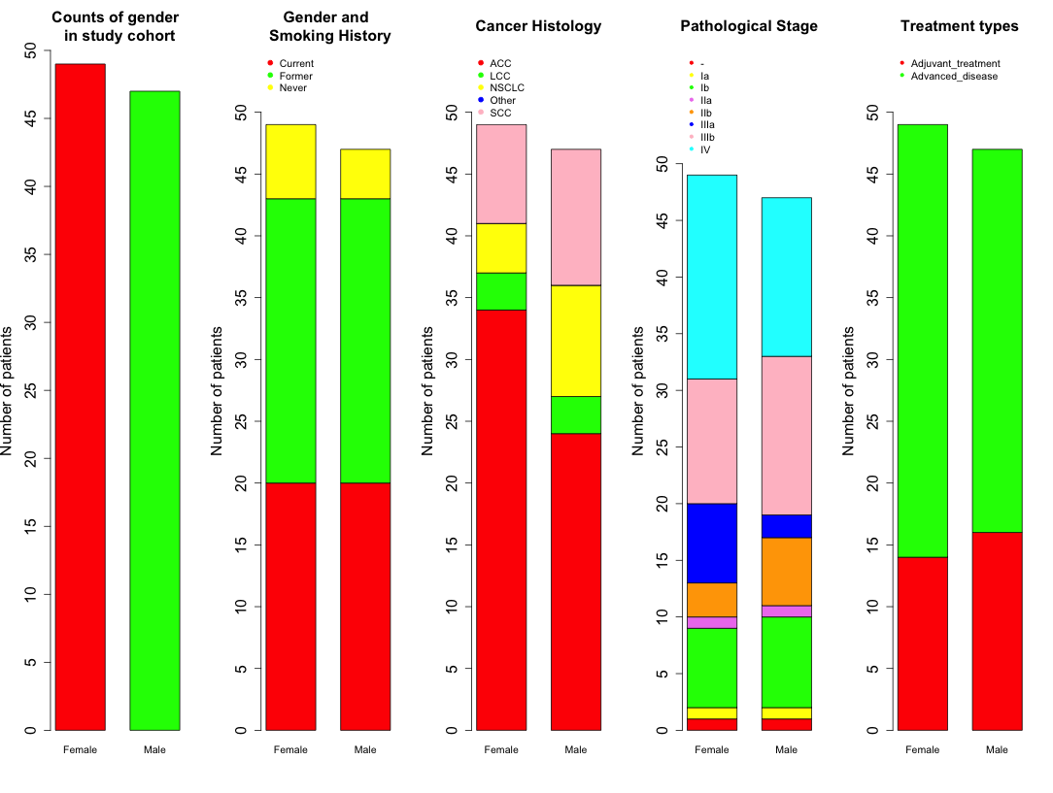
Extreme phenotypes of 96 sample
Subsampled from original 215 patient sample
Summary statistics of all 96 extreme samples
Both male and female sample show variations in cancer histology

Slide 7
Toxicity information of samples
Quantitative measures of blood count values of individual blood cells i.e thrombocytes, leukocytes and neutrophils
Baseline values → Blood count data before treatment
Nadir values → drop of blood count data after treatment
Additionally, Toxicity information was provided as Qualitative measures of CTCEA (Common toxicity criteria v2.0) based CTC scores for individual adverse effect
Grades included are:
0 = No adverse event or within normal limits
1 = Mild adverse event
2 = Moderate adverse event
3 = Severe and undesirable adverse event
4 = Life-threatening or disabling adverse event

Slide 8
Correlating Nadir values CTC scores of blood counts
CTC score are based on nadir values of individual blood count
Huge Variability blood count observed for each of phenotypes although patients were extreme phenotypes

Slide 9
Decrease in count is not even in all phenotypes
Arbitrary set values 80% decrease
33 NPK
52 TPK
22 LPK
Baseline and nadir values used to calculate decrease values

Slide 10
Thus, the problem remained if we take classification based on CTC score
How to set threshold for example to set high and low toxicity
How to classify into low and high toxicity based in 5 tier CTC score
How to deal with CTC score values of 2 to which we assign the category?

Slide 11
Exploratory analysis based on Principal Component analysis
Principal component analysis to observe variation and pattern in dataset
PCA plot labeled with CTC score of TPK
Components explaining variances in data

Slide 12
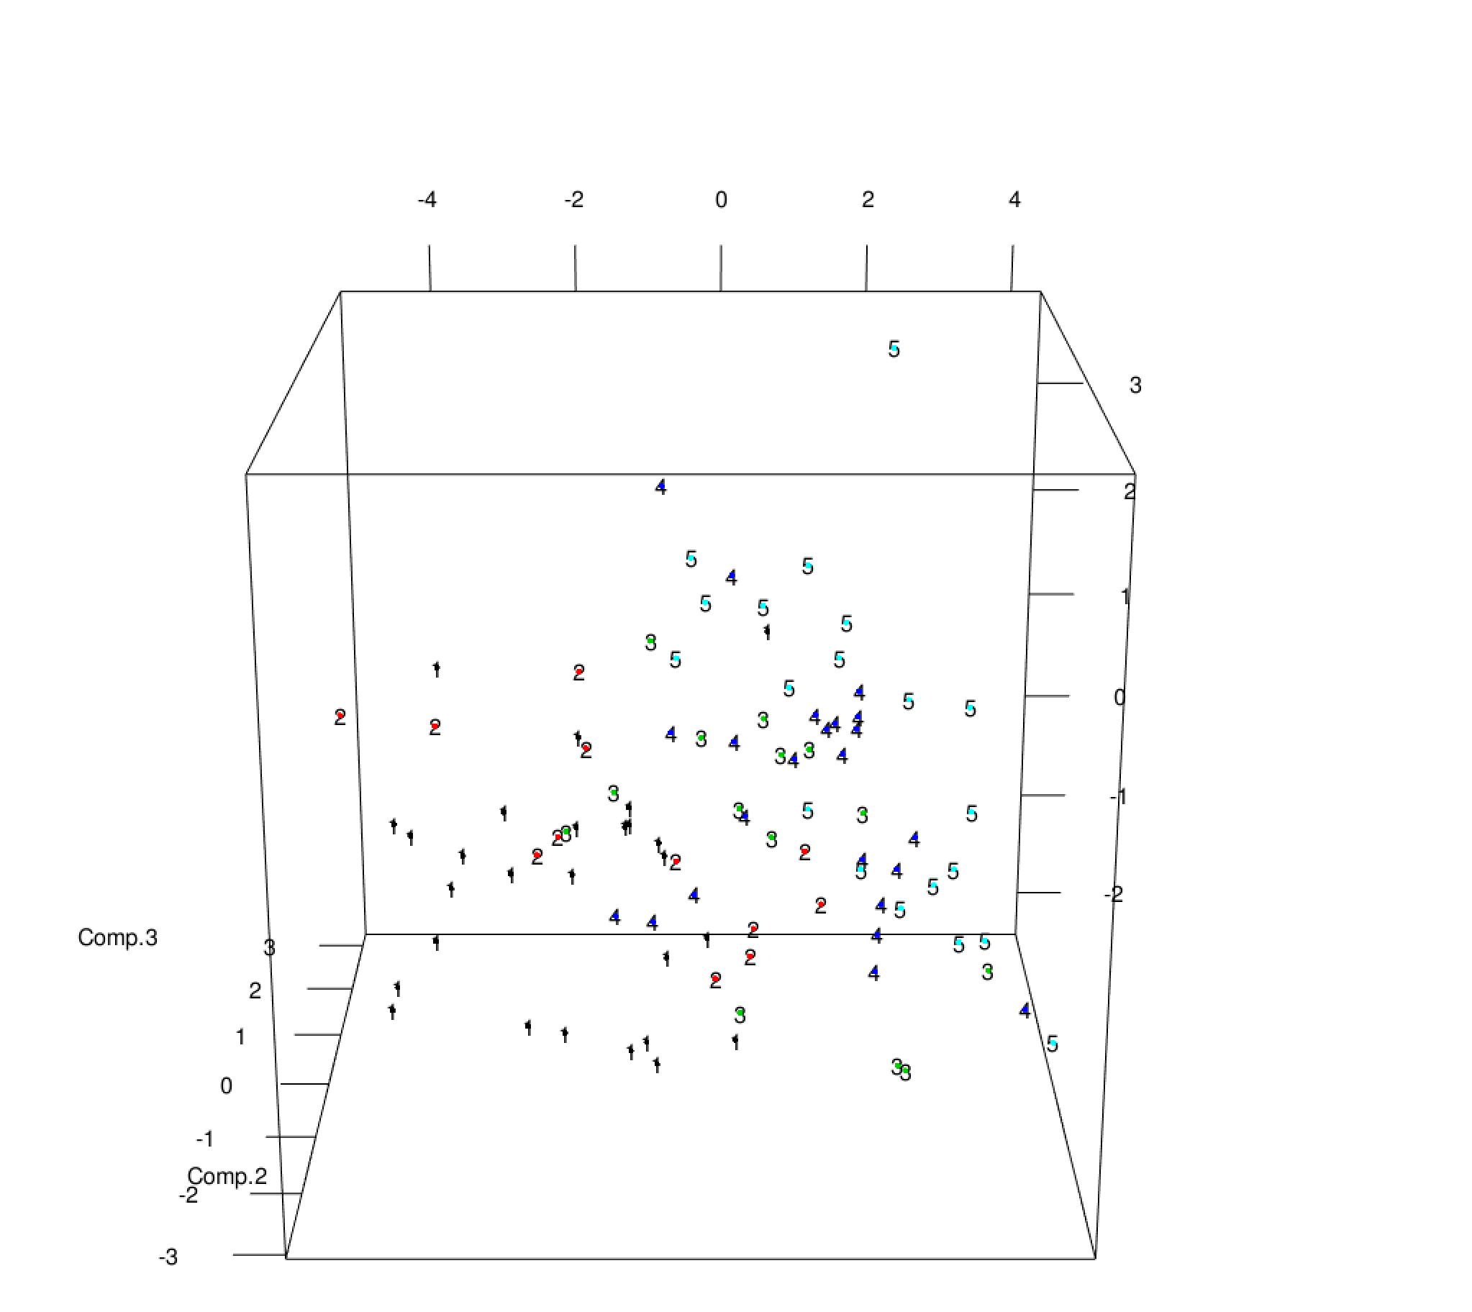
3D Visualization of PCA plot
Thus, PCA implicated there is some hidden clusters within the data
Unsupervised based clustering ??

Slide 13
Unsupervised clustering
Without prior knowledge or information
Cluster patients into 2 groups
Use all the available quantitative information (baseline and nadir count) skipping CTC scores
Try with different clustering methods
Validate and use results from a cluster method

Slide 14
Clustering method 1: K - means clustering
Partition data into 2 clusters belonging to the nearest mean
However, data has to be fixed
Log₁₀ normalization for phenotype count data for both baseline and nadir values
Impute missing data based on iterative PCA

Slide 15
Result 1
Fig: Clustering result for High and low toxicity
Assignment of samples based on above clustering
High Toxicity | Low Toxicity
54 | 42

Slide 16
Evaluation of clustering method
Set a rule for classification based hard threshold of CTC scores in each phenotype
Classification rule:
if:
CTC toxicity score of either 3 or 4 in any of phenotype count —> High Toxicity
else:
Classify patients —> Low Toxicity
Assignment of patient to toxicity group based on hard threshold
High Toxicity | Low Toxicity
54 | 42

Slide 17
PCA plot is more clear with labels from toxicity groups

Slide 18
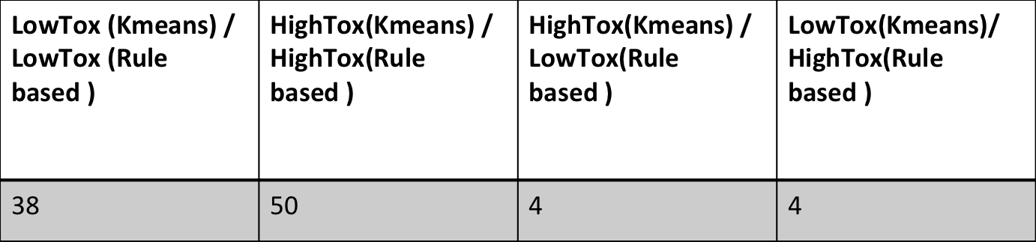
Evaluation of kmeans clustering of data
Compared clustering of Kmeans and CTC based clustering of patients into groups
Confusion Matrix :
Predicted clusters from Kmeans(2)
Actual Cluster (Rule based ) |  | HT | LT
 | HT | 50 (TP) | 4 (FN)
 | LT | 4 (FP) | 38 (TN)

Slide 19
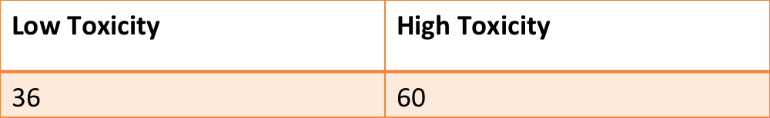
Probabilistic based unsupervised clustering
Maximum likelihood estimation of data
Expectation-Maximization algorithm
2 cluster defined
Number of patient identified in each group

Slide 20
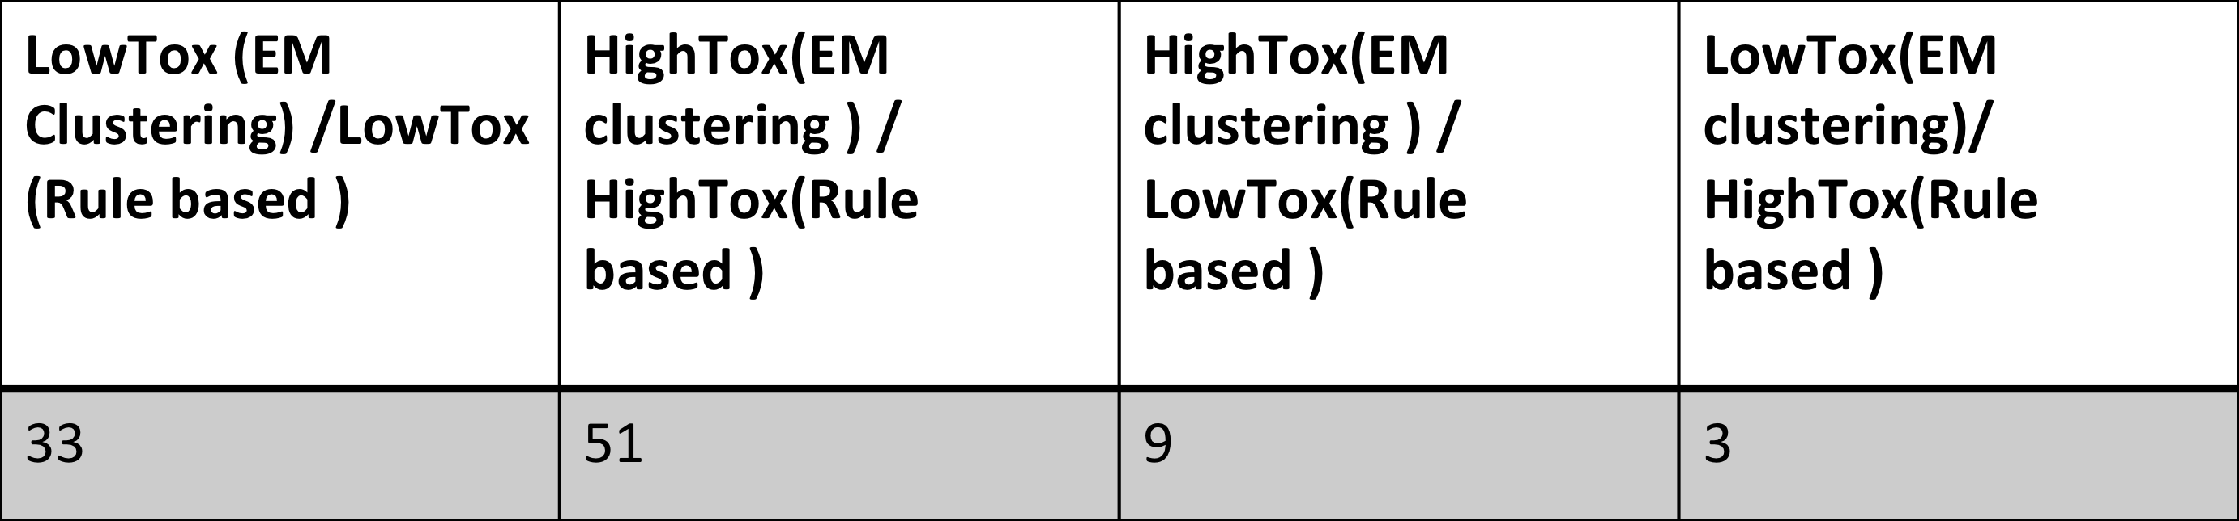
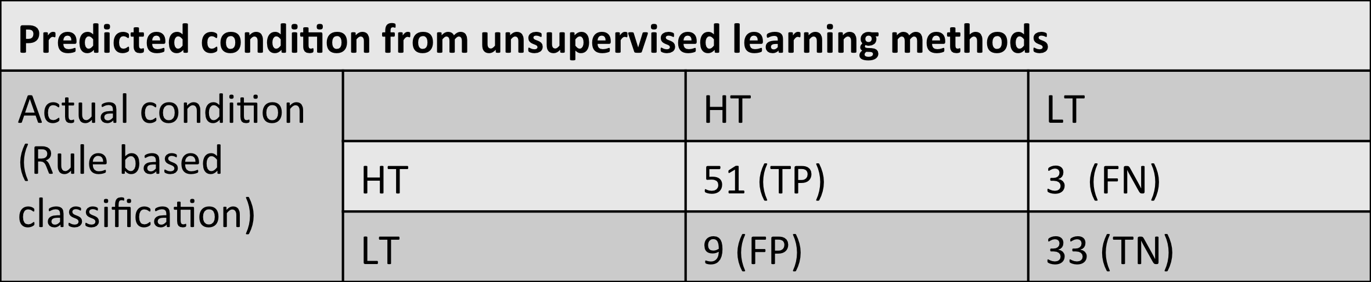
Evaluation of two EM cluster and rule based cluster
Confusion Matrix :

Slide 21
Which to choose from two clustering methods??
Receiver operation curve for 2 unsupervised methods
Graphical plot to evaluate the clustering methods
Area Under the curve (AUC) represents the accuracy of clustering methods
Kmeans performed better for our dataset

Slide 22
Thus, from above experiments
Kmeans and EM based clustering on log10 baseline and nadir count data
Default 2 chosen so to classify into high and low toxicity groups
Kmeans based clustering was taken for further processing
Further work on calling of SNVs and SVs from each group
Report enrichment in each group and connect to phenotypes

